Slide 1

FEM Solver of a General Composite Supersonic Wing(Static Analysis)
Anirudh K
ME22MTECH14017
MTech in Aerospace Specialization
Mechanical and Aerospace Engineering
Analysis and Design of Composites
ME5700

Slide 2
Outline
Motivation
Introduction
FEM Formulation and Assumptions involved
Materials used and Assumptions involved
Methodology
Results
Conclusion

Slide 3
Motivation
To apply the concepts of Composite theory and FEM.
To create a small and innovative project which couples FEM and Composite.
To apply the concepts of FEM and Composite in Aerospace domain.

Slide 4
Introduction
Supersonic wings are aerodynamically thin and has low aspect ratio i.e. less span and greater area which is ideal in assuming that it can be modelled as Plate.
Since it is a plate and to compute the transverse displacement we make use of Mindlin Plate theory which is given by [4].
The solver can take any span, root chord and sweep along with composite material in spar web, spar cap, rib web, rib cap and skin of any material, number of lamina and thickness.

Slide 5
FEM Formulation and Assumptions involved
The kinematics involved are Mindlin plate theory which involve Legendre Polynomials as basis function for the displacements involved.[4]
Artificial stiffness are given to the geometry to account for the deformation along with method of removing of variables.[4]
Reduced order is done to take care of shear locking in artificial stiffness(tips of the wing) and out of plane displacements.

Slide 6


Materials used and Assumptions involved(1/2)
The Assumption that the transverse displacement are not present in a lamina are broken to account for the independent degrees of freedom for the Mindlin plate theory.
The Stiffness matrix for in plane and out of plane are given as follows.
The out of plane strain is taken care by reduced order integration.

Slide 7
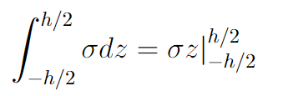
Material used and Assumption involved(2/2)
The variation of stress along the laminate is integrated along the thickness hence the stiffness values are integrated throughout the laminate.
The equation is given by

Slide 8
Methodology
The airfoil curve equation are predicted using the paper[5] using lsqcurvefit inbuilt MATLAB function whose analytical expression are used in the thickness direction of the wing which is then coupled with spar cap, spar web, rib web and rib cap.
Then we apply Legendre polynomials which is multiplied with the constitutive matrix to get the stiffness matrix along with reduced order integration.
Artificial stiffness is applied along with reduced order integration at the tips of the wing.
Boundary conditions is clamped free wing.

Slide 9
Results
The following test for convergence was done:
Leading edge sweep is 30 degree.
Span of the entire wing is 13.56m.
Root chord is 6m.
Aspect ratio is 3.3541.
Airfoil used is a supercritical airfoil which satisfies aerodynamic requirements.
Weight/Load applied is F22 Raptor’s weight.
Number of lamina is 4 with orientation [0 90]_{s}
Thickness is assumed to be 1mm throughout the lamina
Dimensions of spar and ribs are 1000mm or 1m.

Slide 10
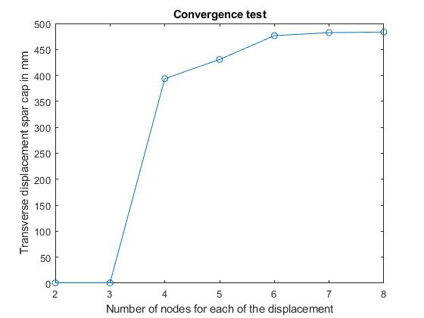
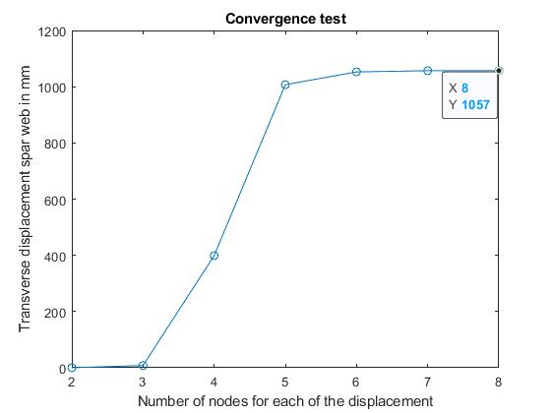
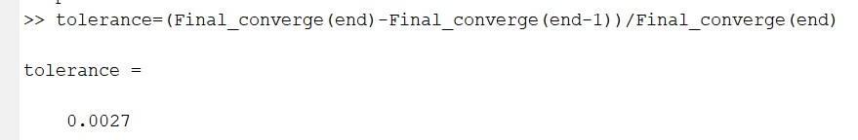
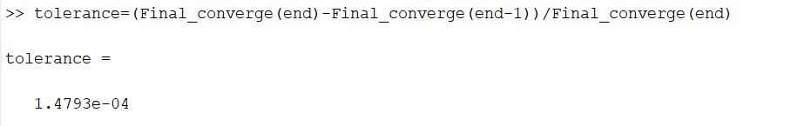
Convergence plots

Slide 11
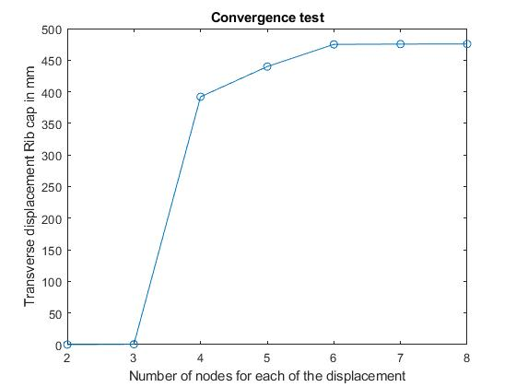
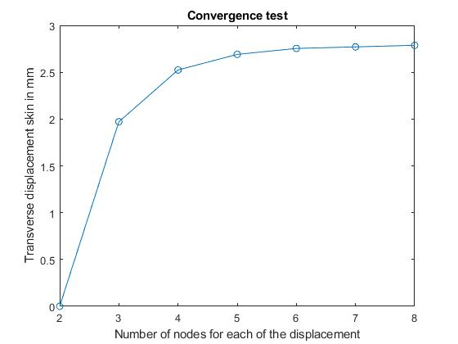
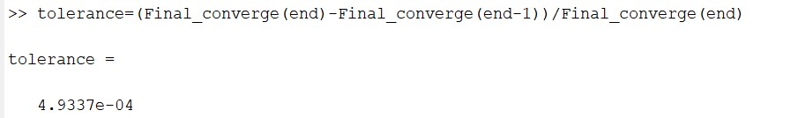
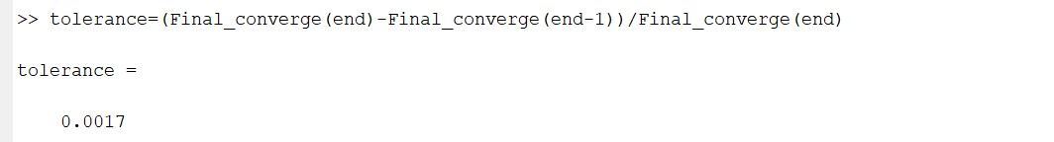

Slide 12
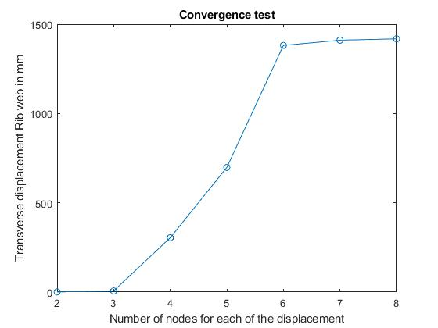

Slide 13
Conclusion
The displacements are reasonable.
The solver can be used for any dimensions, sweep, material, angle of each ply and thickness of each ply.
Run time for each part of the code is around 2-3 minutes which is faster than a commercial packages which has a lot of degrees of freedom.
Tolerance is 1e-03 and it is convenient to use it commercially.
Can be extrapolated to find stress, strain, failure criteria.

Slide 14
References
[1] Carbon fibre material property, http://www.performance-composites.com/
carbonfibre/mechanicalproperties_2.asp
[2] F-22 Raptor weight https://www.af.mil/About-Us/Fact-Sheets/Display/Article/104506/f-22-raptor/
[3] Sc(2)-0714 supercritical airfoil nasasc2-0714-il. http://airfoiltools.com/
airfoil/details?airfoil=nasasc2-0714-il.
[4] Rakesh K. Kapania and Youhua Liu. Static and vibration analyses of general
wing structures using equivalent-plate models. AIAA Journal, 38(7):1269–1277,
2000
[5] Brenda M. Kulfan. Universal parametric geometry representation method. Jour-
nal of Aircraft, 45(1):142–158, 2008.

Slide 15
[7] Andrew Elwyn Lovejoy. Natural frequencies and an atlas of mode shapes for generally-laminated, thick, skew, trapezoidal plates. PhD thesis, Virginia Tech, 1994.

